Slide 1
Social Engineering LAB

Slide 2
Objectives and Tasks
Each Team will create a phishing email
Once Create the phishing email will be sent to a designate email

Slide 3
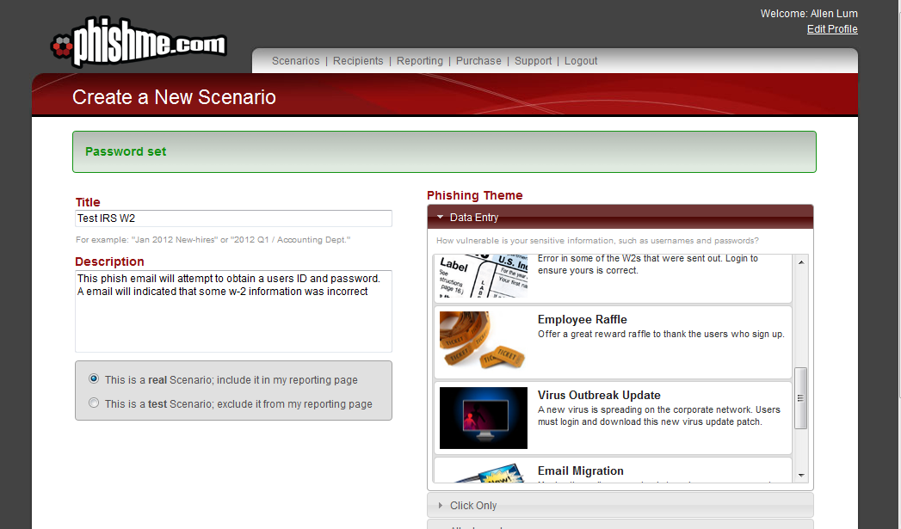
Step 1

Slide 4
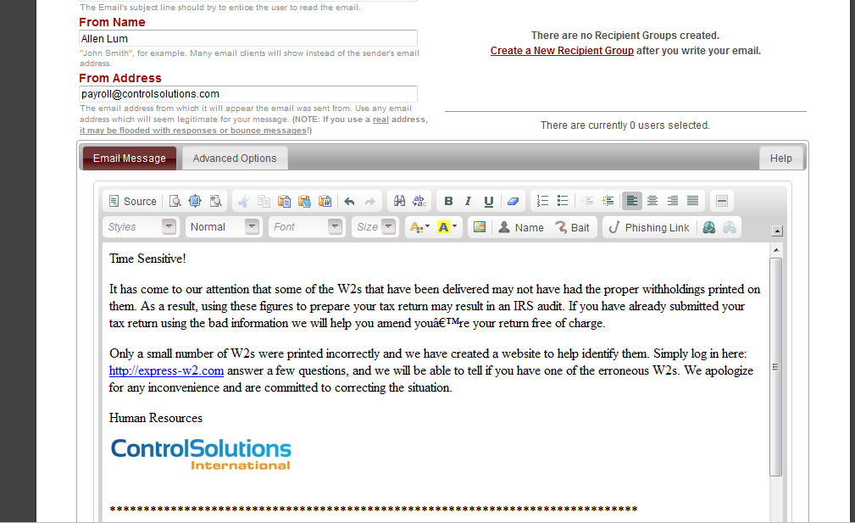
Step 2
The phisihing email is created.
Add a “From”
Customized as Required

Slide 5
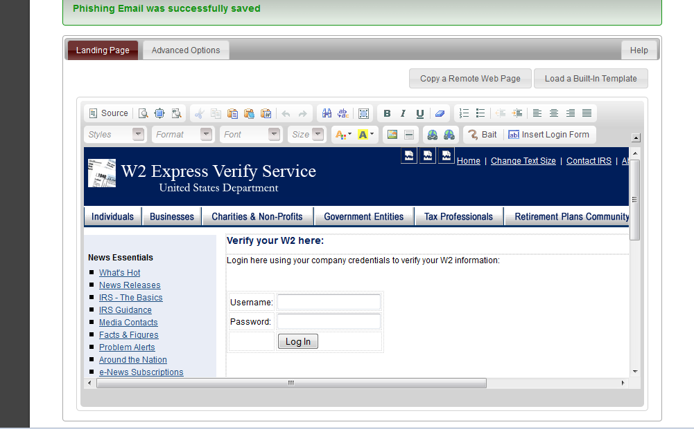
Step 3
Create a Landing Page. In this case one was created for you.

Slide 6
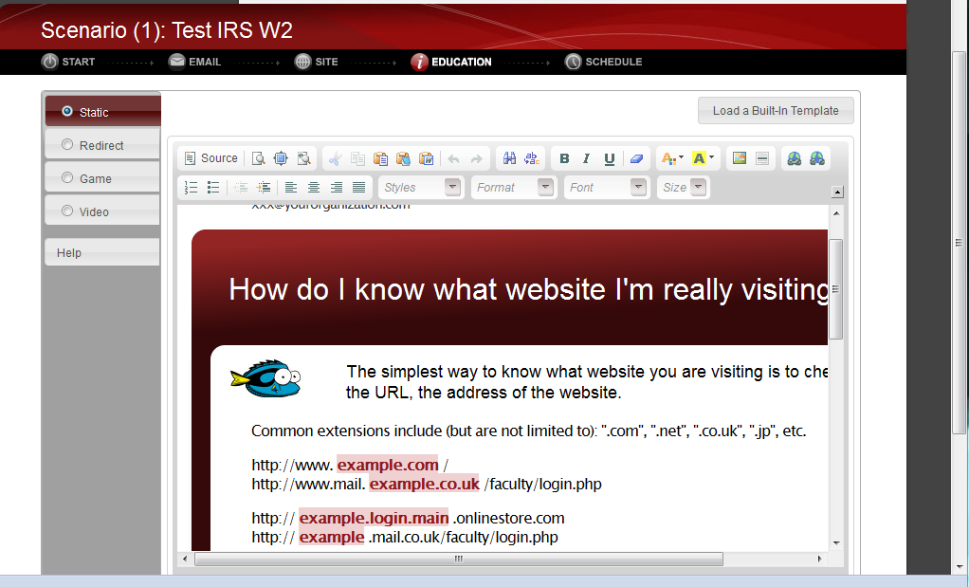
Results
A results – If the user does not detect that this is a phishing attack.

Slide 7
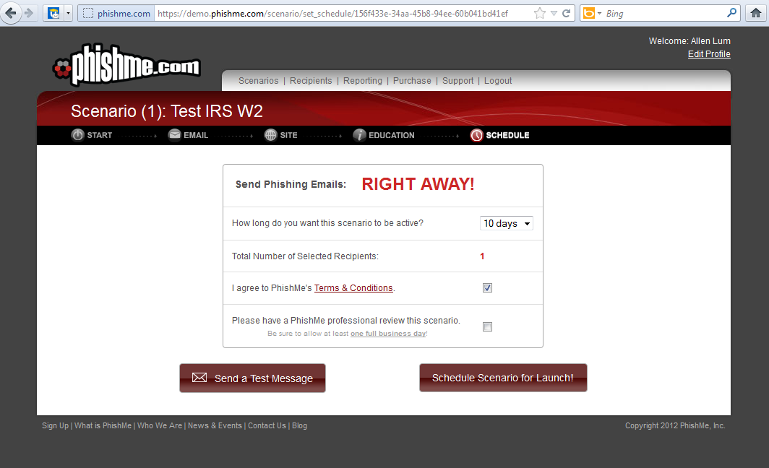
Launch Email

Slide 8
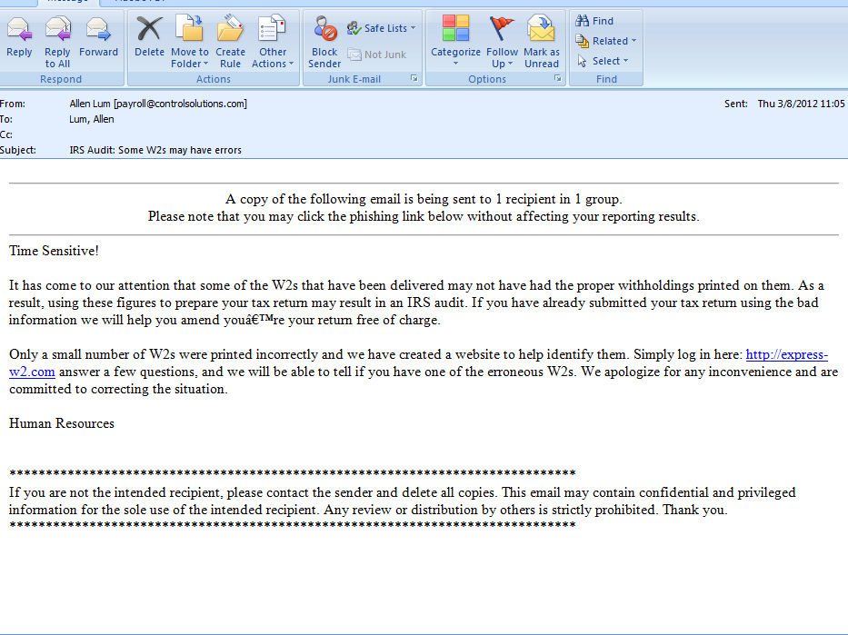
Results

Slide 9
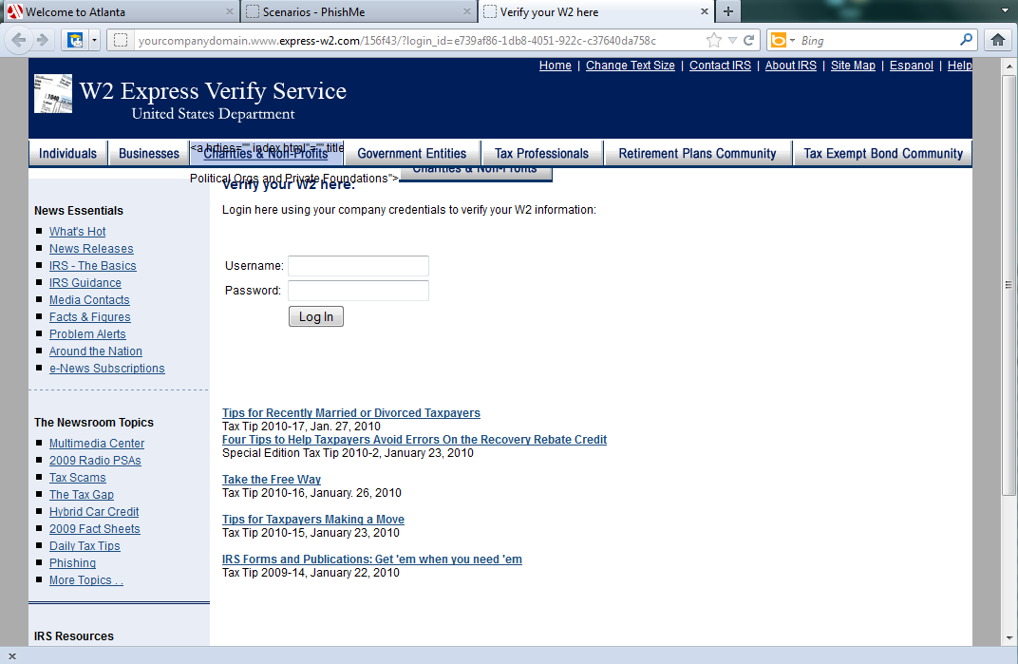
Landing Page

Slide 10
Your Turn
Divide into Groups
Develop a phishing email provided in the templates
Feel free to customize the text
Sent it only to alum@controlsolutions.com
The class will pick the Winner !!

